Slide 1
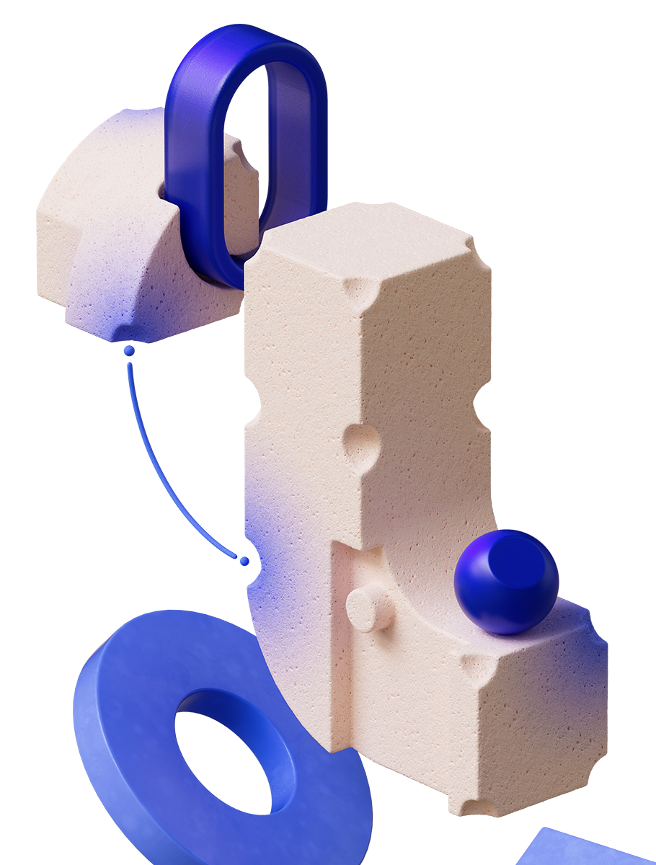
Learned Optimizers for LLM Fine-Tuning
mh/238422
Gus Kristiansen, Mark Sandler, Andrey Zhmoginov, Nolan Miller, Jihwan Lee, Max Vladymyrov

Slide 2
Learned Optimizers for LLM Fine-Tuning
Fine-tuning has become the critical and ubiquitous step to customize a model. Thousands of fine-tuning jobs are running right now, consuming vast computational resources.
Despite the explosion in training, optimizer technology hasn't kept pace. We're still largely relying on hand-tuned optimizers like RMSProp, AdaFactor, or Adam. The needle hasn't really moved.
Here, we propose a lightweight, efficient learned optimizer specifically designed for fine-tuning LLM.

Slide 3

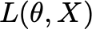
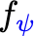
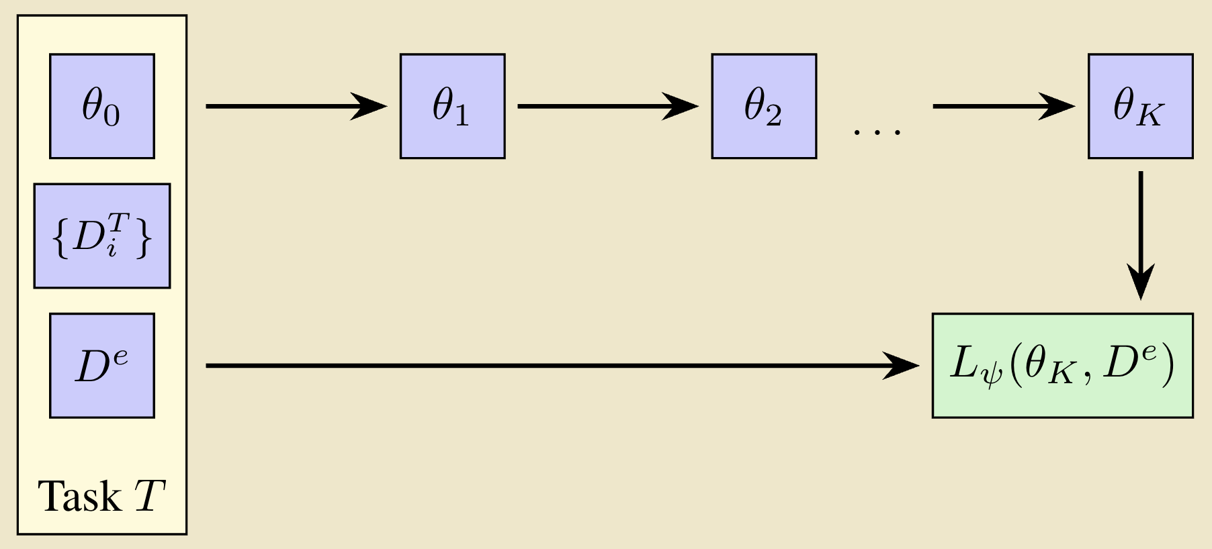

Learned Optimizers: Preliminaries
1️⃣ Sample K training batches . and 1 evaluation batch . from a new task T.
2️⃣Update weights with K steps over .
For a loss function with weights , a learned optimizer updates the model's weights with:
Features : a collection describing optimization statistics (e.g., gradient, loss).
Meta-parameters : learned parameters of the meta-optimizer.
4️⃣ Repeat on new tasks till convergence of .
3️⃣ Update meta-parameters . using . on the evaluation batch .
For example, a trivial learned optimizer can learn the learning rate of SGD using the current gradient information:
5️⃣ After training, the optimizer can be applied to any task similar to the tasks in the training set.
Some recent examples from the literature:
BLUR (Sandler et al, 2021)
VeLO (Metz et al, 2022)
µLo (Thérien et al, 2024)
… many others

Slide 4
The Promise of Learned Optimizers
Learned Optimizers offer adaptive optimizer custom-built for your distribution, but their limitations prevent widespread use.
Benefits
Limitations
Efficiency. Achieves comparable or better results with fewer iterations.
Adaptability. The optimizer automatically adjusts to your data. There are no hyper-parameters to tune.
Over-Specialization. Often excel for tasks that are close to their training domain.
Step-Limited. Struggle to generalize to longer training regime (>10K of iterations).
Computationally Heavy. The weight updates can be expensive to compute.
Modern optimization problems often involves fine-tuning a model from a pre-existing checkpoint. This addresses two limitations:
Limitation (i): we can leverage the model and checkpoint's inductive bias.
Limitation (ii): fine-tuning typically requires fewer optimization steps.
Our lightweight optimizer design specifically addresses the third limitation.

Slide 5
Design & Vision
Our Design Principle
Develop a lightweight and efficient optimizer specifically designed for fine-tuning a given Gemini model:
Lightweight & Efficient: Minimal overhead, fast.
Specialized for Fine-tuning: Optimized for model & checkpoint in mind.
Our Vision for the Future
New Gemini models ships with an optimal learned optimizer for best fine-tuning results:
Out-of-the-box fast and efficient performance.
No optimizer guesswork.
No hyper-parameters to tune.

Slide 6
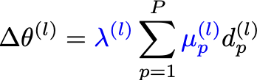
Learned Layer-wise Learning Rate Scheduler
Key idea
A learned optimizer designed for fine-tuning LLMs that acts a wrapper around a set of base optimizer directions, learning a linear combination of directions and a learning rate for each layer of the model.
Benefits:
Lightweight & Efficient for LLMs. Ideal for fine-tuning large models, even with limited memory.
Bring-your-own-optimizer. As a wrapper, it is easily integratable to any set of existing base optimizers (optax wrapper included).
Improved Generalization. Adapts effectively to various out-of-distribution datasets.
Separate direction for each layer of the network.
Set of P normalized directions given by some known minimizers.
Learned hyper-parameters: mixing coefficients and learning rate.
Learned hyper-parameters: mixing coefficients and learning rate.

Slide 7
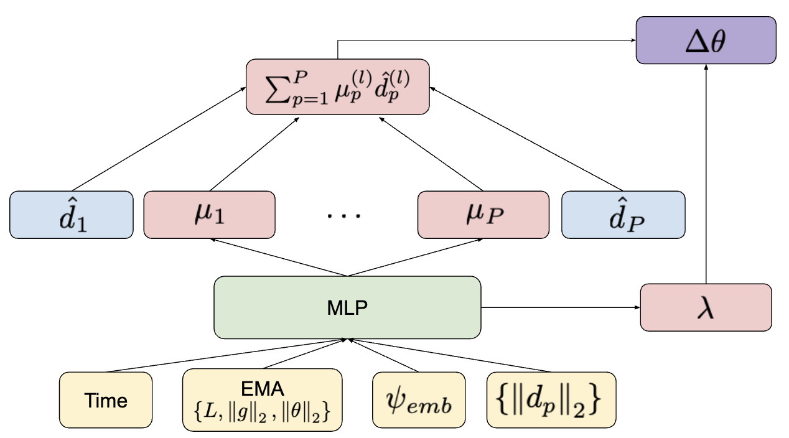
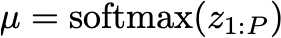
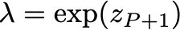
Learned Optimizer Features and Output
The learned optimizer is applied for each layer with the following inputs:
Time. Optimization training progress.
Relative Time: Fraction of the current training run completed.
Absolute Time: Total training duration.
Adaptive EMAs with different smoothing factors:
Loss EMA: Long-term trend of training loss.
Gradient Norm EMA: Long-term trend of gradient magnitude.
Weight Norm EMA: Long-term trend of weight magnitude.
Layer Embeddings. Learned vector for each layer.
Base Optimizer Magnitude. Norm of every base optimizer’s direction.
The inputs are processed by a two-layer MLP with ReLU activations.
The final parameters are computed from the logits z using
and .

Slide 8
Experiments
Model: ULM 1B.
Task: Full fine-tuning.
Meta-training: Tasks sampled from ReCoRD dataset using NES. Every task is optimized for 10 to 200 iterations.
Evaluation: 25 different datasets. Evaluated for 200 iterations total.
Ours: learned optimizer that wraps AdaFactor and SGD.
Baselines: variants of AdaFactor, SGD, Shampoo with hand-tuned learning rates and schedules.
Optimizer Details:
Efficient: Our optimizer has minimal overhead, requiring only a single 2-layer MLP pass per iteration, unlike baselines like Shampoo.
Flexible: We experiment with full fine-tuning, but it also works with other parameter-efficient fine-tuning methods like LoRA.

Slide 9
Meta-training dataset
Example passage
(CNN) -- A lawsuit has been filed claiming that the iconic Led Zeppelin song "Stairway to Heaven" was far from original. The suit, filed on May 31 in the United States District Court Eastern District of Pennsylvania, was brought by the estate of the late musician Randy California against the surviving members of Led Zeppelin and their record label. The copyright infringement case alleges that the Zeppelin song was taken from the single "Taurus" by the 1960s band Spirit, for whom California served as lead guitarist. "Late in 1968, a then new band named Led Zeppelin began touring in the United States, opening for Spirit," the suit states. "It was during this time that Jimmy Page, Led Zeppelin's guitarist, grew familiar with 'Taurus' and the rest of Spirit's catalog. Page stated in interviews that he found Spirit to be 'very good' and that the band's performances struck him 'on an emotional level.' "
• Suit claims similarities between two songs
• Randy California was guitarist for the group Spirit
• Jimmy Page has called the accusation "ridiculous"
ReCoRD Dataset (Zhang et al., 2018):
Task: multiple-choice QA task.
Data Source: CNN & Daily Mail news articles.
Input: news article, cloze-style question (entity masked), list of candidate entities.
Output: predicted entity (multiple surface forms allowed).
Size: 100730 / 10000 / 10000 (train/test/val).
Example query
According to claims in the suit, "Parts of 'Stairway to
Heaven,' instantly recognizable to the music fans across
the world, sound almost identical to significant portions
of ‘X.’”
Example answer
Taurus
Notes:
Query
Reference Answers

Slide 10
Evaluation datasets: SuperGlue
Task Name | Task Description | Data Source | Size (Train/Val/Test)
COPA | Premise/Cause/Effect Multiple-Choice Question Answering | Various (Open-domain corpora) | 400 / 100 / 500
RTE | Textual Entailment (Binary Classification) | Various News and Wikipedia | 2490 / 277 / 3000
WIC | Word Sense Disambiguation Binary Classification | WordNet, VerbNet, Wiktionary | 5428 / 638 / 1400
MULTIRC | Multiple-Choice Reading Comprehension | Various (News, Stories, etc.) | 27243 / 4848 / 9693
BOOLQ | Yes/No Question Answering Binary Classification) | Wikipedia passages | 9427 / 3270 / 3245
WSC | Coreference Resolution Binary Classification - Winograd Schema | Books, Narratives | 554 / 146 / 104
CB | Textual Entailment Three-way Classification - entailment, contradiction, or neutral | WSJ, fiction, conversations | 250 / 250 / 56

Slide 11
Evaluation datasets: UnifiedQA
Task Name | Task Description | Data Source | Size (Train/Val/Test)
NARRATIVEQA | Summary Understanding | Book summaries and complete books | 32747 / 3572 / 10508
NEWSQA | Extractive Question Answering | A set of news articles from CNN | 75882 / 4309
QUOREF | Co-reference Resolution | Wikipedia | 19399 / 2418 / 2418
RACE_STRING | Multiple-Choice Reading Comprehension | English exams for Chinese students | 87866 / 4887 / 4934
DROP | Discrete Reasoning Over Paragraphs | Wikipedia | 77409 / 9536 / 9649
SQUAD1_1 | Extractive Question Answering | Wikipedia | 130319 / 6078 / 5915
OPENBOOKQA | Multiple-Choice Science Question Answering | Elementary-level science facts | 4957 / 500 / 500
AMBIGQA | Open-Domain Question Answering (with ambiguous questions) | Questions from "Natural Questions" data | 10047 / 2002 / 2002
COMMONSENSQA | Multiple-Choice Question Answering (testing commonsense knowledge) | ConceptNet (knowledge graph) | 9741 / 1221 / 1140
NATURAL_QUESTIONS | Open-Domain Question Answering | Google search queries + Wikipedia | 307373 / 7830 /7842
PHYSICAL_IQA | Physical interactions | Various | 16113 / 1838 / 2081
QASC | Reasoning Multiple-Choice Science | Elementary-level science facts + background corpus | 8134 / 926 / 920
ROPES | Reading Comprehension | Wikipedia and News-like passages | 10680 / 1675 / 1674

Slide 12
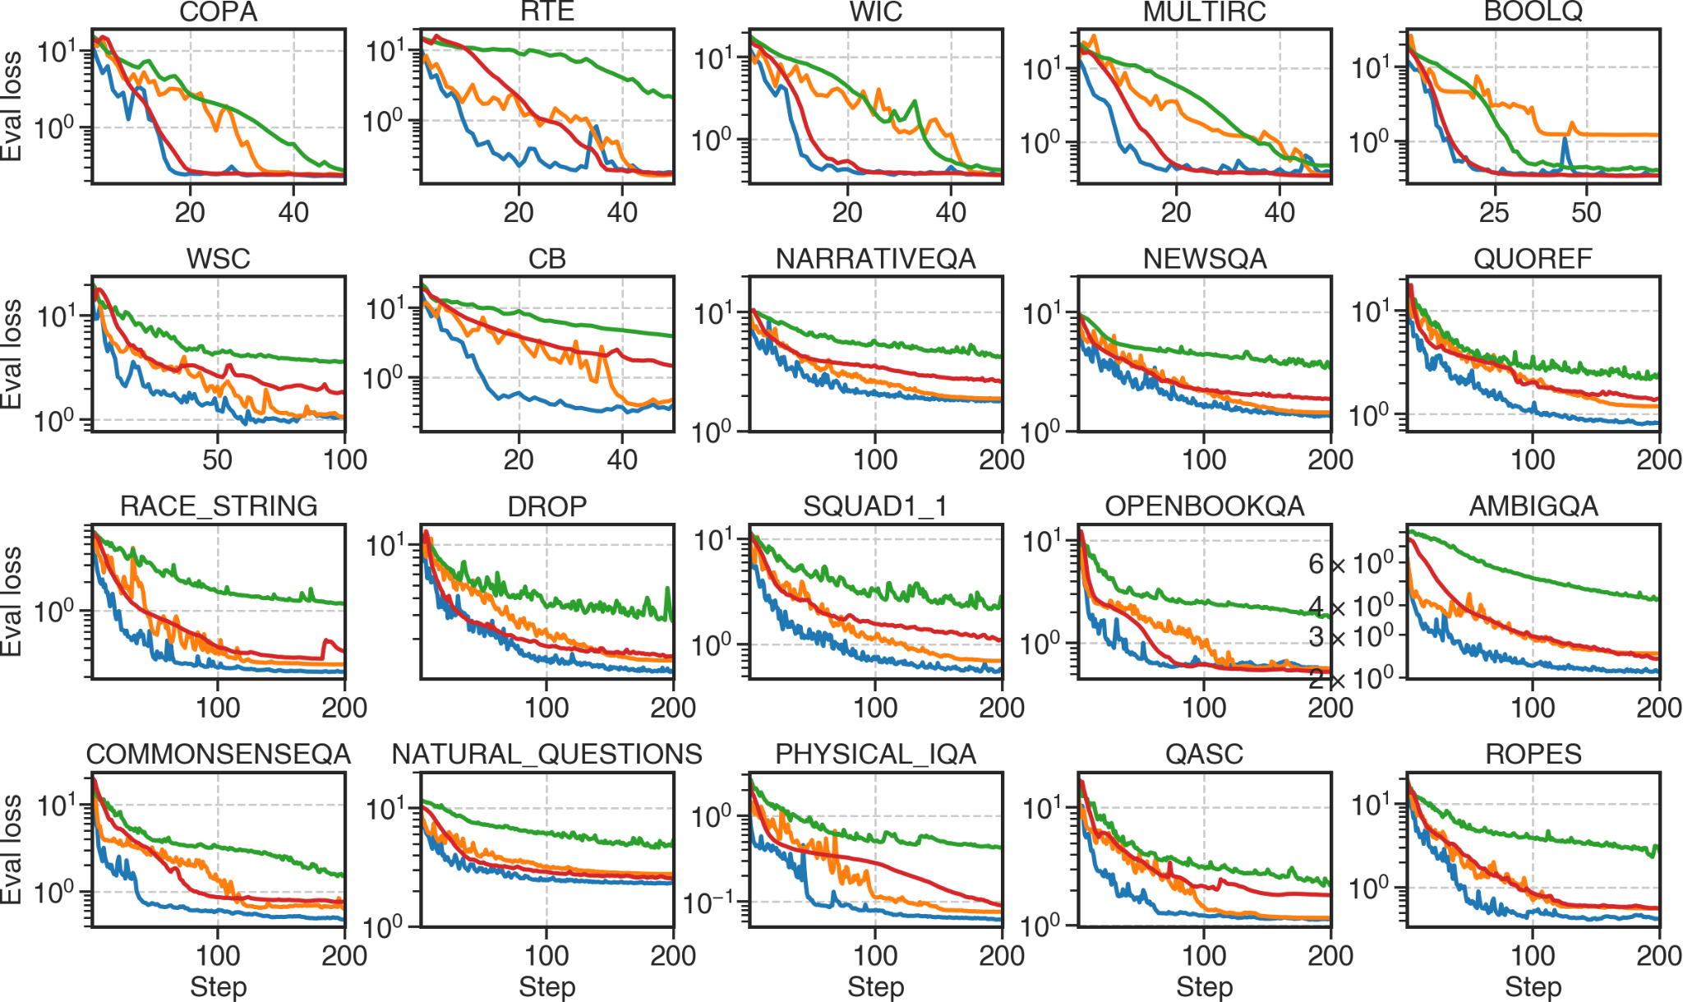
Evaluation performance
In most cases, our learned algorithm is both better and faster than general optimizers.
AdaFactor most of the times converges to a good minima, but it usually takes much longer.
Shampoo is sometimes comparable, but it is very expensive to run wrt memory and compute.

Slide 13
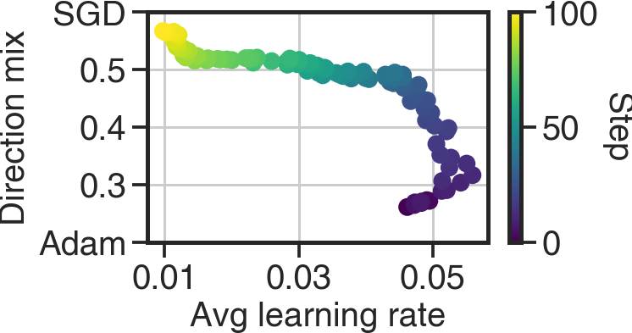
Interpretability of Learned Meta-Parameters
Final switch to SGD right before convergence.
Rapid decay of the learning rate.
Switch from AdaFactor towards SGD
SGD
A direction mix parameter:
lower – more AdaFactor, higher – more SGD.
AdaFactor
Our optimizer provides interpretable outputs, revealing insights into training dynamics. For instance, we can examine average values across all layers at every optimization step:
Visible learning rate patterns (warm-up, decay).
AdaFactor → SGD shift: Our optimizer exploits SGD's strength near the optimum (where Adam/AdaFactor can struggle).
Learning rate warm up

Slide 14
Future Work: Scaling to Extremely Large Models
Goal: Develop an optimizer that can work for large-scale models, without the need for meta-training.
Proposed Solutions:
Extrapolation Training: Train models of progressively increasing sizes. Then, use the learned patterns to extrapolate the behavior and performance of a significantly larger model, beyond the sizes directly trained.
Leveraging Scaling Laws: We can also incorporate biases from established optimization scaling laws with respect to the model size (e.g. µLo paper, Thérien et al (2024)).

Slide 15
Future Work: Developing "Safe Optimizers"
Goal: Create optimization algorithms that can maintain a high level of performance on a predefined safety benchmark, while minimizing performance on a primary task.
Proposed Solutions:
Adding a Safety Optimizer: Including a "safety direction" within the set of base optimizers used during meta-training. Think of this as a specialized optimizer focused solely on safety.
Augmenting the Meta-Loss: Adding a safety-specific loss term to the overall meta-loss function. This loss quantifies how well the model performs on the safety dataset.

Slide 16
Conclusions
Are Learned Optimizers ready for prime time? We believe yes!
We hypothesize that an optimizer tailored to a specific model and checkpoint can generalize effectively across diverse fine-tuning datasets.
We've developed a lightweight learned optimizer designed specifically for this purpose.
Our optimizer achieves performance that matches or surpasses hand-tuned optimizers on 25 diverse tasks, demonstrating strong generalization even far beyond the training dataset.

